Slide 1
Compilers
Lexical Analysis

Slide 2
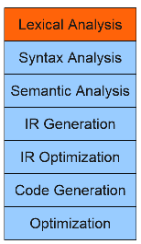
Lexical Analysis
while (y < z) {
int x = a + b;
y += x; }

Slide 3
Lexemes vs Tokens
Input Stream:
while (y < z) {
int x = a + b;
y += x; }
Token Stream:
T_While T_LeftParen T_Identifier y T_Less T_Identifier z T_RightParen T_OpenBrace T_Int T_Identifier x T_Assign T_Identifier a T_Plus T_Identifier b T_Semicolon T_Identifier y T_PlusAssign T_Identifier x T_Semicolon T_CloseBrace

Slide 4
Goals of Lexical Analysis (Scanner)
Convert from physical description of a program into sequence of tokens.
Each token is associated with a lexeme.
Each token may have optional attributes.
The token stream will be used in the parser to recover the program structure.
Scanner
Parser
source
tokens

Slide 5
Challenges in Lexical Analysis
How to partition the program into lexemes?
How to label each lexeme correctly?

Slide 6
Defining a Lexical Analysis
Define a set of tokens.
Define the set of lexemes associated with each token.
Define an algorithm for resolving conflicts that arise in the lexemes.
It often consumes a surprising amount of the compiler’s total execution time.

Slide 7
Choosing Tokens
What Tokens are Useful Here?
for (int k = 0; k < myArray[5]; ++k) {
cout << k << endl; }
For {
IntConstant }
Int <<
Identifier ;
= <
( [
) ]
++

Slide 8
Choosing Good Tokens
Give keywords their own tokens.
Give different operators and punctuation symbols their own tokens.
Discard irrelevant information (whitespace, comments)

Slide 9
Tokens in Programming Languages
Operators & Punctuation
+ - * / ( ) { } [ ] ; : :: < <= == = != ! …
Each of these is a distinct lexical class
Keywords
if while for goto return switch void …
Each of these is also a distinct lexical class (not a string)
Identifiers
A signle ID lexical class, but parameterized by actual id
Integer constants
A single INT lexical class, but parameterized by int value
Other constants, etc.

Slide 10
Defining Sets of Strings

Slide 11
String Terminology
An alphabet Σ is a set of characters.
A string over Σ is a finite sequence of elements from Σ.
Example:
● Σ = {☺, ☼ }
● Valid strings include ☺, ☺☺, ☺☼, ☺☺☼, etc.
● The empty string of no characters is denoted ε.

Slide 12
Languages
A language is a set of strings.
Example: Even numbers
● Σ = {0, 1, 2, 3, 4, 5, 6, 7, 8, 9}
● L = {0, 2, 4, 6, 8, 10, 12, 14, … }
Example: C variable names
● Σ = ASCII characters
● L = {a, b, c, …, A, B, C, …, _, aa, ab, … }

Slide 13
Regular Languages
A subset of all languages that can be defined by regular expressions.
Any character is a regular expression matching itself. (a is a regular expression for character a)
ε is a regular expression matching the empty string.

Slide 14
Operations on Regular Expressions
If R1 and R2 are two regular expressions, then:
● R1R2: is a regular expression matching the concatenation of the languages.
● R1 | R2: is a regular expression matching the disjunction of the languages.
● R1*: is a regular expression matching the Kleene closure of the language (0 or more occurrences ).
● (R): is a regular expression matching R.

Slide 15
Example
Example 3.4: Let Σ = {a, b}. (page 122)
The regular expression a|b denotes the language {a, b}.
(a|b)(a|b) denotes {aa, ab, ba, bb}, the language of all strings of length two over the alphabet Σ. Another regular expression for the same language is aa|ab|ba|b.
a* denotes the language consisting of all strings of zero or more a's, that is, {ε,a,aa,aaa,...}

Slide 16
Example
Example 3.4: Let Σ = {a, b}. (page 122)
(a|b)* denotes the set of all strings consisting of zero or more instances of a or b, that is, all strings of a's and b's: {e,a, b,aa, ab, ba, bb,aaa,...}. Another regular expression for the same language is (a*b*)*
a|a*b denotes the language {a, b, ab, aab, aaab,...}, that is, the string a and all strings consisting of zero or more a's and ending in b.

Slide 17
Abbreviations
The basic operations generate all possible regular expressions, but there are common abbreviations used for convenience. Typical examples:
Abbr. | Meaning | Notes
r+ | (rr*) | 1 or more occurrences
r? | (r | ε) | 0 or 1 occurrence
[a-z] | (a|b|…|z) | 1 character in given range
[abxyz] | (a|b|x|y|z) | 1 of the given characters

Slide 18
More Examples
re | Meaning
[abc]+
[abc]*
[0-9]+
[1-9][0-9]*
[a-zA-Z][a-zA-Z0-9_]*

Slide 19
Regular Definitions
For notational convenience, we may give names to certain regular expressions and use those names in subsequent expressions, as if the names were themselves symbols.

Slide 20
Regular Definitions
Example: Even Numbers
(+|-|ε) (0|1|2|3|4|5|6|7|8|9)*(0|2|4|6|8)
Regular Definitions:
Sign → + | -
OptSign → Sign | ε (Sign ?)
Digit → [0 – 9] (0 | 1 | ….. | 9)
EvenDigit → [02468] (0 | 2 | 4 | 6 | 8)
EvenNumber → OptSign Digit* EvenDigit

Slide 21
More Examples
Example 3.5: (page 123) C identifiers are strings of letters, digits, and underscores. Here is a regular definition for the language of C identifiers. We shall conventionally use italics for the symbols defined in regular definitions.
letter_ → A|B|….|Z|a|b|….|z |_
digit → 0 | 1 | …… | 9
id → letter _( letter_| digit )*

Slide 22
More Examples
Example 3.6: (page 123) Unsigned numbers (integer or floating point) are strings such as 5280, 0.01234, 6.336E4, or 1.89E-4. The regular definitions:
digit → 0 | 1 | ..... | 9
digits → digit digit*
optionalFraction → .digits | ε
optionalExponent →( E ( + | - | ε ) digits ) | ε
number → digits optionalFraction optionalExponent

Slide 23
More Examples
Example 3.7: (page 124) we can rewrite the regular definition of Example 3.5 as:
letter_ →[A-Za-z_]
digit → [0-9]
id → letter_ ( letter_| digit )*
The regular definition of Example 3.6 can also be simplified:
digit → [0-9]
digits → digit+
number → digits (. digits)? ( E [+-]? digits )?

Slide 24
Implementing Regular Expressions
Regular expressions can be implemented using finite automata.
There are two kinds of finite automata:
● NFAs (nondeterministic finite automata)
● DFAs (deterministic finite automata)
The step of implementing the lexical analyzer

Slide 25
Finite State Automaton
A finite set of states
One marked as initial state
One or more marked as final states
States sometimes labeled or numbered
A set of transitions from state to state
Each labeled with symbol from Σ, or ε
Notes:
Au02: from CSE401 Sp02 notes

Slide 26
Finite State Automaton
Operate by reading input symbols (usually characters)
Transition can be taken if labeled with current symbol
ε-transition can be taken at any time
Accept when final state reached & no more input
Reject if no transition possible, or no more input and not in final state (DFA)
Notes:
Au02: from CSE401 Sp02 notes

Slide 27
Example: FSA for “cat”
Start
Accept
c
a
t

Slide 28
A Simple FSA

Slide 29
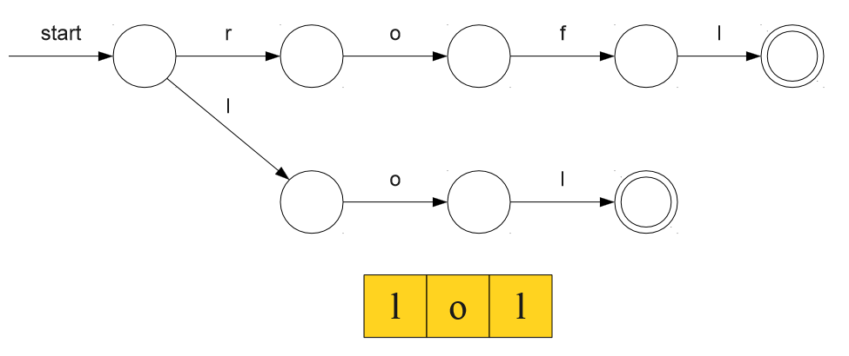
A Simple FSA

Slide 30
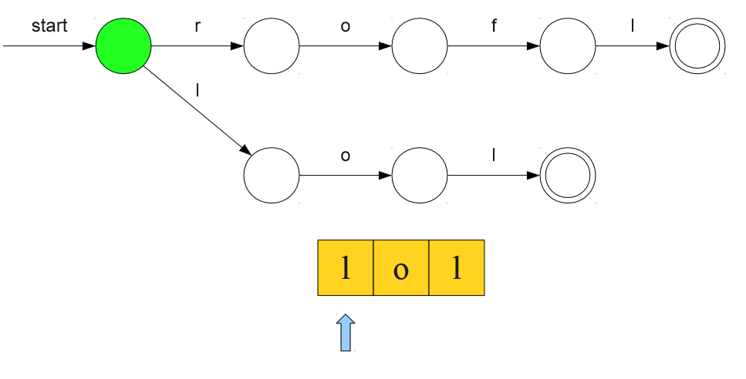
A Simple FSA

Slide 31
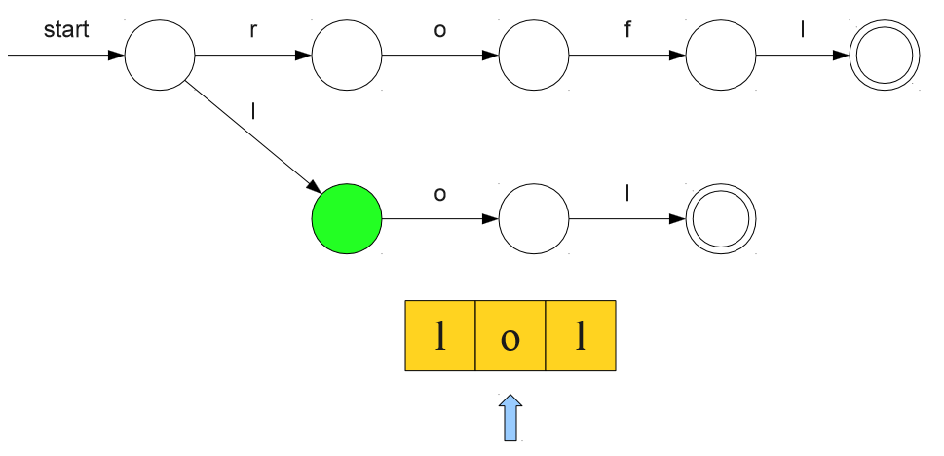
A Simple FSA

Slide 32
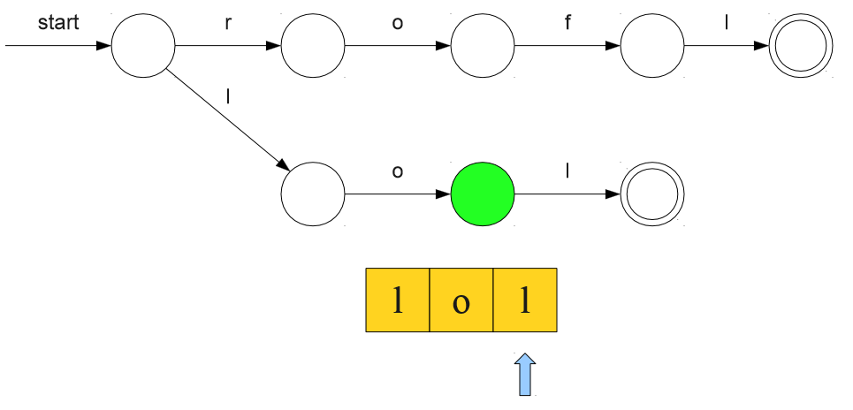
A Simple FSA

Slide 33
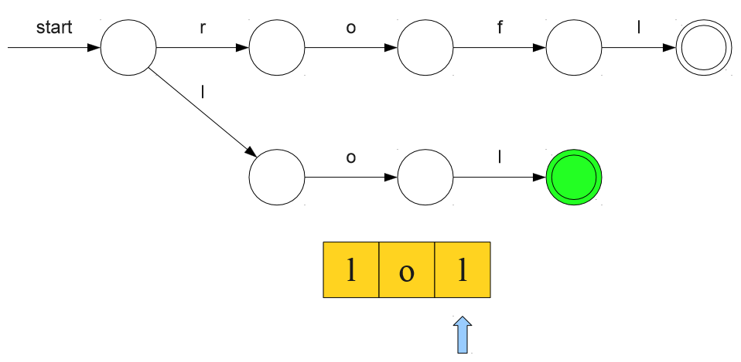
A Simple FSA

Slide 34
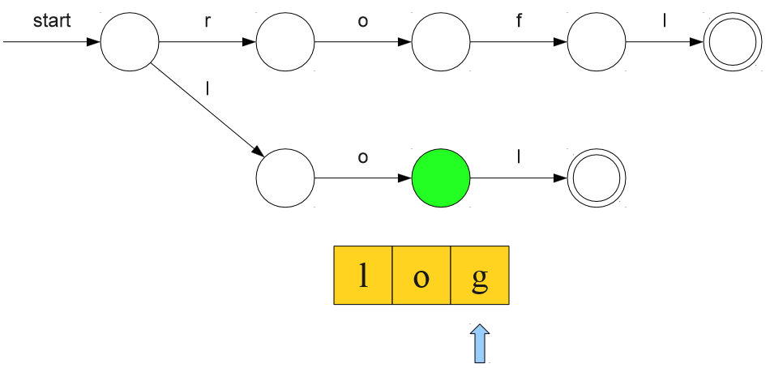
A Simple FSA

Slide 35
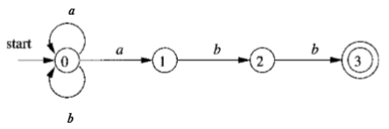
Example
Example 3.14: (page 148) The transition graph for an FSA recognizing the language of regular expression (a|b)*abb is shown in Fig. 3.24.

Slide 36
Transition Tables
We can also represent an FSA by a transition table, whose rows correspond to states, and whose columns correspond to the input symbols and ε
The entry for a given state and input is the value of the transition function applied to those arguments.
If the transition function has no information about that state-input pair, we put 0 in the table for the pair.

Slide 37
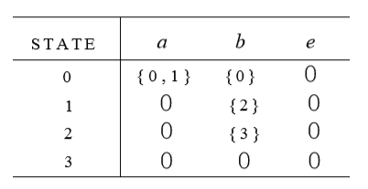
Transition Tables
Example 3.15: (page 149) The transition table for the FSA of the example 3.14 is:

Slide 38
Acceptance of Input Strings by Automata
Example 3.16: (page 149) The string aabb is accepted by the FSA of the example 3.14. The path labeled by aabb from state 0 to state 3 demonstrating this fact is:
Note that several paths labeled by the same string may lead to different states. For instance, path
This path leads to state 0, which is not accepting.
a
a
b
b
0
0
1
2
3
a
a
b
b
0
0
0
0
0

Slide 39
From Regular Expressions to NFAs
Associate each regular expression with an NFA with the following properties:
There is exactly one accepting state.
There are no transitions out of the accepting state.
There are no transitions into the starting state.
Accept

Slide 40
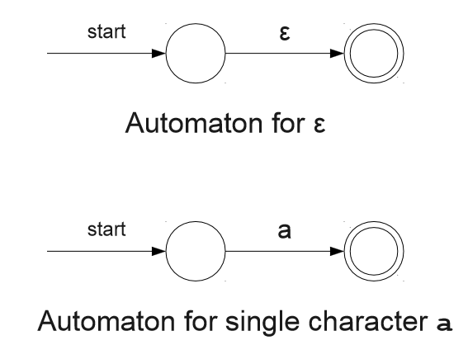
Base Cases

Slide 41
Construction for st

Slide 42
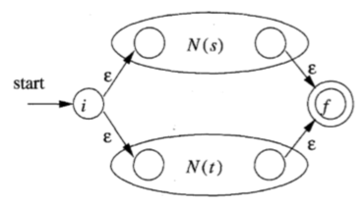
Construction for s|t

Slide 43
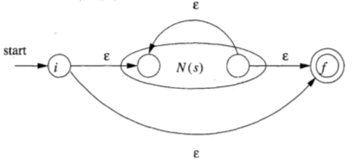
Construction for s*

Slide 44
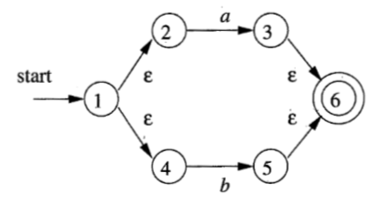
Example
Construct the NFS for the regular expression
(a l b)*abb
NFA for a l b

Slide 45
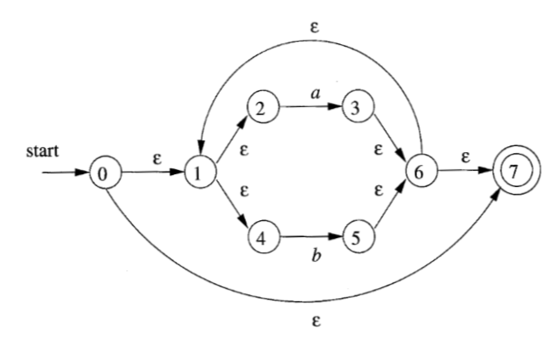
Example
NFA for (a l b)*

Slide 46
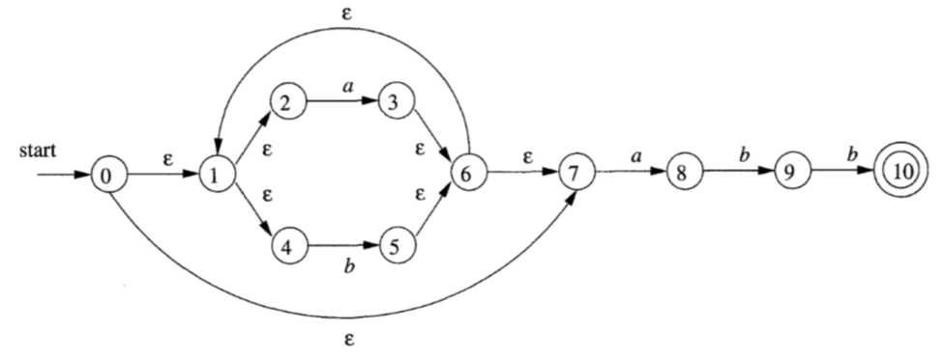
Example
NFA for (alb)*abb

Slide 47
Speeding Up The Scanner
A DFA is like an NFA, but with tighter restrictions
Every state must have exactly one transition defined for every letter.
ε-moves are not allowed.

Slide 48
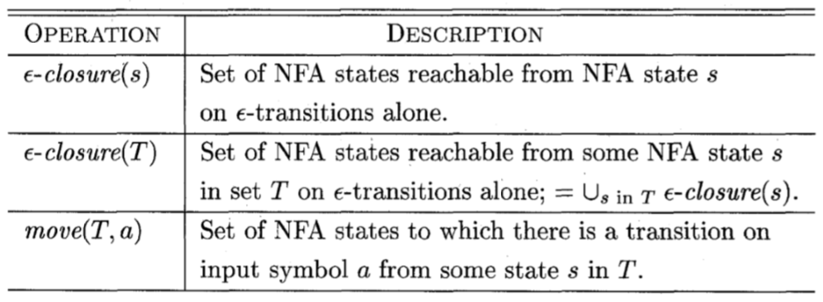
From NFA to DFA
constructs a transition table Dtran for DFA.
Each state of DFA is a set of NFA states
Note that s is a single state of NFA, while T is a set of states of NFA.

Slide 49
From NFA to DFA
Example 3.21 : (page 154) for the NFA accepting (a1 b) *abb;
ε-closure(0) = {0,1,2,4,7} = A
since these are exactly the states reachable from state 0 via a path all of whose edges have label ε.
Note that a path can have zero edges, so state 0 is reachable from itself by an ε -labeled path.

Slide 50
From NFA to DFA
The input alphabet is {a, b). Thus, our first step is to mark A and compute
Dtran[A, a] = ε -closure(move(A, a))
Dtran[A, b] = ε - closure(move(A, b))
Among the states 0, 1, 2, 4, and 7, only 2 and 7 have transitions on a, to 3 and 8, respectively.
Thus, move(A, a) = {3,8).
Also, ε -closure({3,8}) = {1,2,3,4,6,7,8}
, so we conclude Dtran[A, a] = ε -closure(rnove(A, a)) = ε -closure({3, 8}) = B

Slide 51
From NFA to DFA
Now, we must compute Dtran[A, b]. Among the states in A, only 4 has a transition on b, and it goes to 5. Thus,
Dtran[A, b] = ε -closure(rnove(A, b)) = ε -closure({5}) = {I, 2, 4,5, 6,7} = C
B={1,2,3,4,6,7,8}
Now, we must compute Dtran[B, a].
Dtran[B, a] = ε -closure(rnove(B, a)) = ε -closure({3,8}) = B
Now, we must compute Dtran[B, b].
Dtran[B, b] = ε -closure(rnove(B, b)) = ε -closure({5,9}) = {1, 2, 4, 5, 6, 7, 9} = D

Slide 52
From NFA to DFA
C= {I, 2, 4, 6, 7}
Now, we must compute Dtran[C, a].
Dtran[C, a] = ε -closure(rnove(C, a)) = ε -closure({3,8}) = B
Now, we must compute Dtran[C, b].
Dtran[C, b] = ε -closure(rnove(C, b)) = ε -closure({5}) = C
D= {I, 2, 4, 5, 6, 7, 9}
Now, we must compute Dtran[D, a].
Dtran[D, a] = ε -closure(rnove(D, a)) = ε -closure({3,8}) = B
Now, we must compute Dtran[D, b].
Dtran[D, b] = ε -closure(rnove(D, b)) = ε -closure({5,10}) = {1, 2, 3, 5, 6, 7, 10} = E

Slide 53
From NFA to DFA
E = {1, 2, 3, 5, 6, 7, 10}
Now, we must compute Dtran[E, a].
Dtran[E, a] = ε -closure(rnove(E, a)) = ε -closure({3,8}) = B
Now, we must compute Dtran[E, b].
Dtran[E, b] = ε -closure(rnove(E, b)) = ε -closure({5}) = C

Slide 54
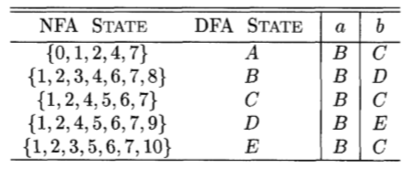
From NFA to DFA
Transition table Dtran for DFA

Slide 55
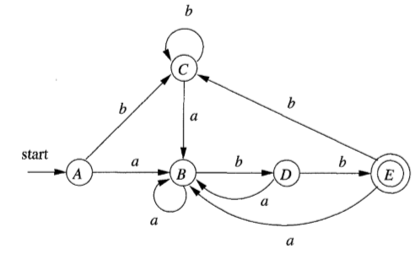
From NFA to DFA
the DFA for (a | b)* abb

Slide 56
Minimizing the Number of States of a DFA
Example 3.40: (page 183) Let us reconsider the previous DFA.
The initial partition consists of the two groups:
{A, B, C, D}{E}
which are respectively the nonac- cepting states and the accepting states.
The group {E} cannot be split, because it has only one state
The other group {A, B, C, D} can be split, so we must consider the effect of each input symbol.

Slide 57
Minimizing the Number of States of a DFA
On input a, each of these states goes to state B, so there is no way to distinguish these states using strings that begin with a.
On input b, states A, B, and C go to members of group {A, B, C, D}, while state D goes to E, a member of another group. So, group{A, B, C, D} could be split into {A, B, C}{D}.
We have now for this round the groups
{A, B, C){D){E}

Slide 58
Minimizing the Number of States of a DFA
In the next round, we can split {A, B, C} into {A, C}{B}, since A and C each go to a member of {A, B, C} on input b, while B goes to a member of another group, {D}.
we cannot split the one remaining group with more than one state, since A and C each go to the same state (and therefore to the same group) on each input.

Slide 59
Minimizing the Number of States of a DFA
The minimum state DFA will be:
b
a
a
a
b
b
A
B
D
E
b
a

Slide 60
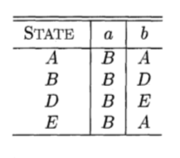
Minimizing the Number of States of a DFA
The transition table of minimum state DFA will be:

